Slide 1
Topics for Discussion
*Recall: Fuzzy Logic Tutorial
Assignment #2: Fuzzy Controller for the Inverted Pendulum Problem
Fuzzy Logic Engine
Simulation System for Assignment #2
World-to-Device Transformation Equations
Physics Equations
Euler’s Method
Double Buffering technique
Main Routines

Slide 2
2 Inputs, 9 rules
Fuzzy Logic Tutorial

Slide 3
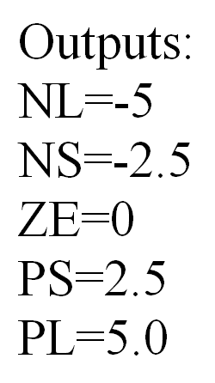
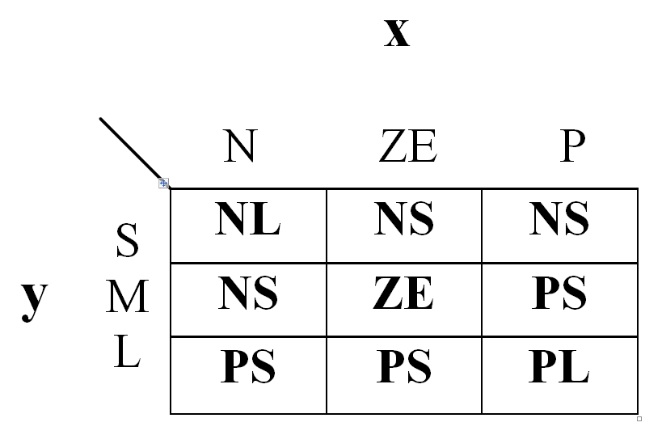
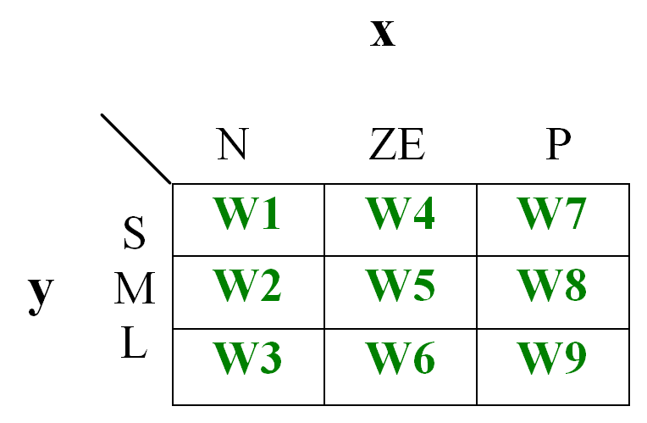
Fuzzy Logic Tutorial
Using the given FAMM, output values and membership functions, calculate the crisp output of the fuzzy system when x = -0.7 and y = -3 .
Assume that the fuzzy combination operator used is the Zadeh AND.
This is used only to refer to each of the rules individually

Slide 4
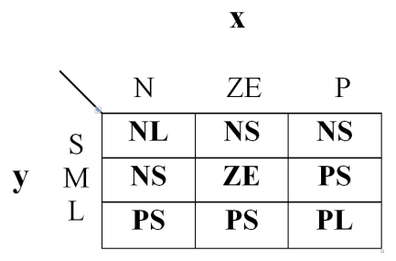
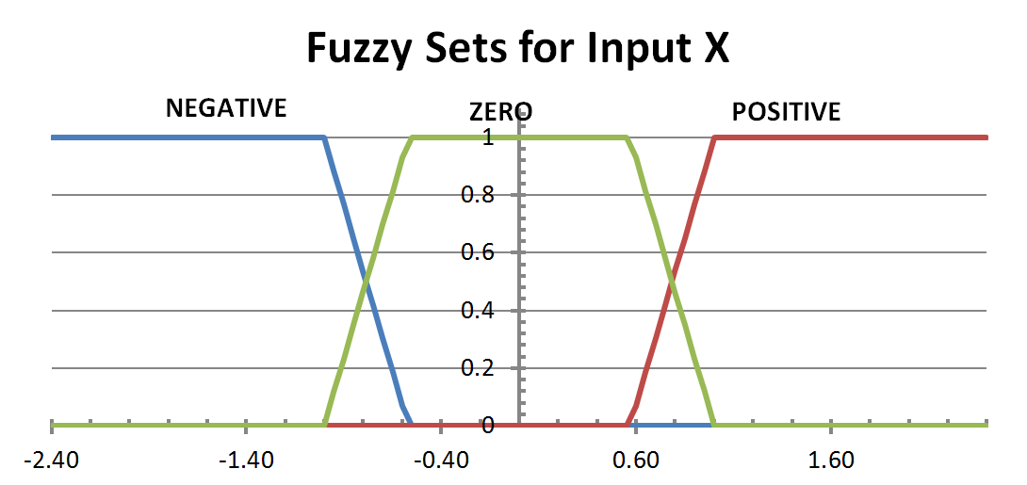
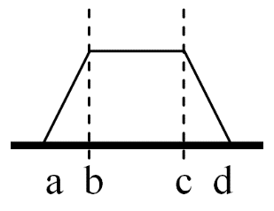
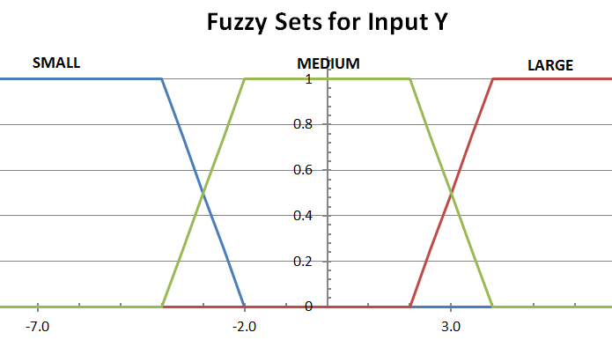
Fuzzy Logic Tutorial
All fuzzy sets are of type trapezoidal.
 | a | b | c | d
NEG | 0 | 0 | -1 | -0.57
ZE | -1 | -0.57 | 0.57 | 1
POS | 0.57 | 1 | 0 | 0
 | a | b | c | d
S | 0 | 0 | -4 | -2
M | -4 | -2 | 2 | 4
L | 2 | 4 | 0 | 0

Slide 5
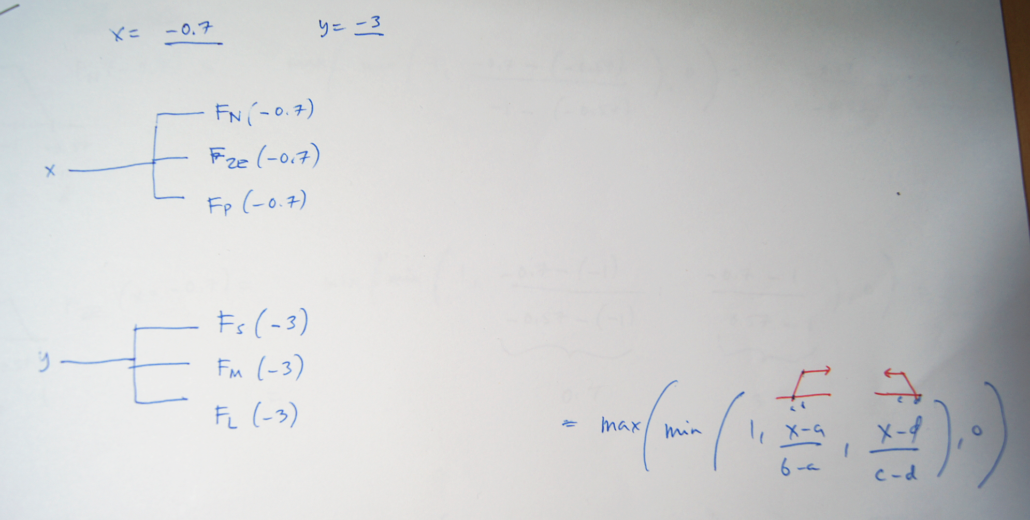
Fuzzy Logic Tutorial
Fuzzify the inputs

Slide 6
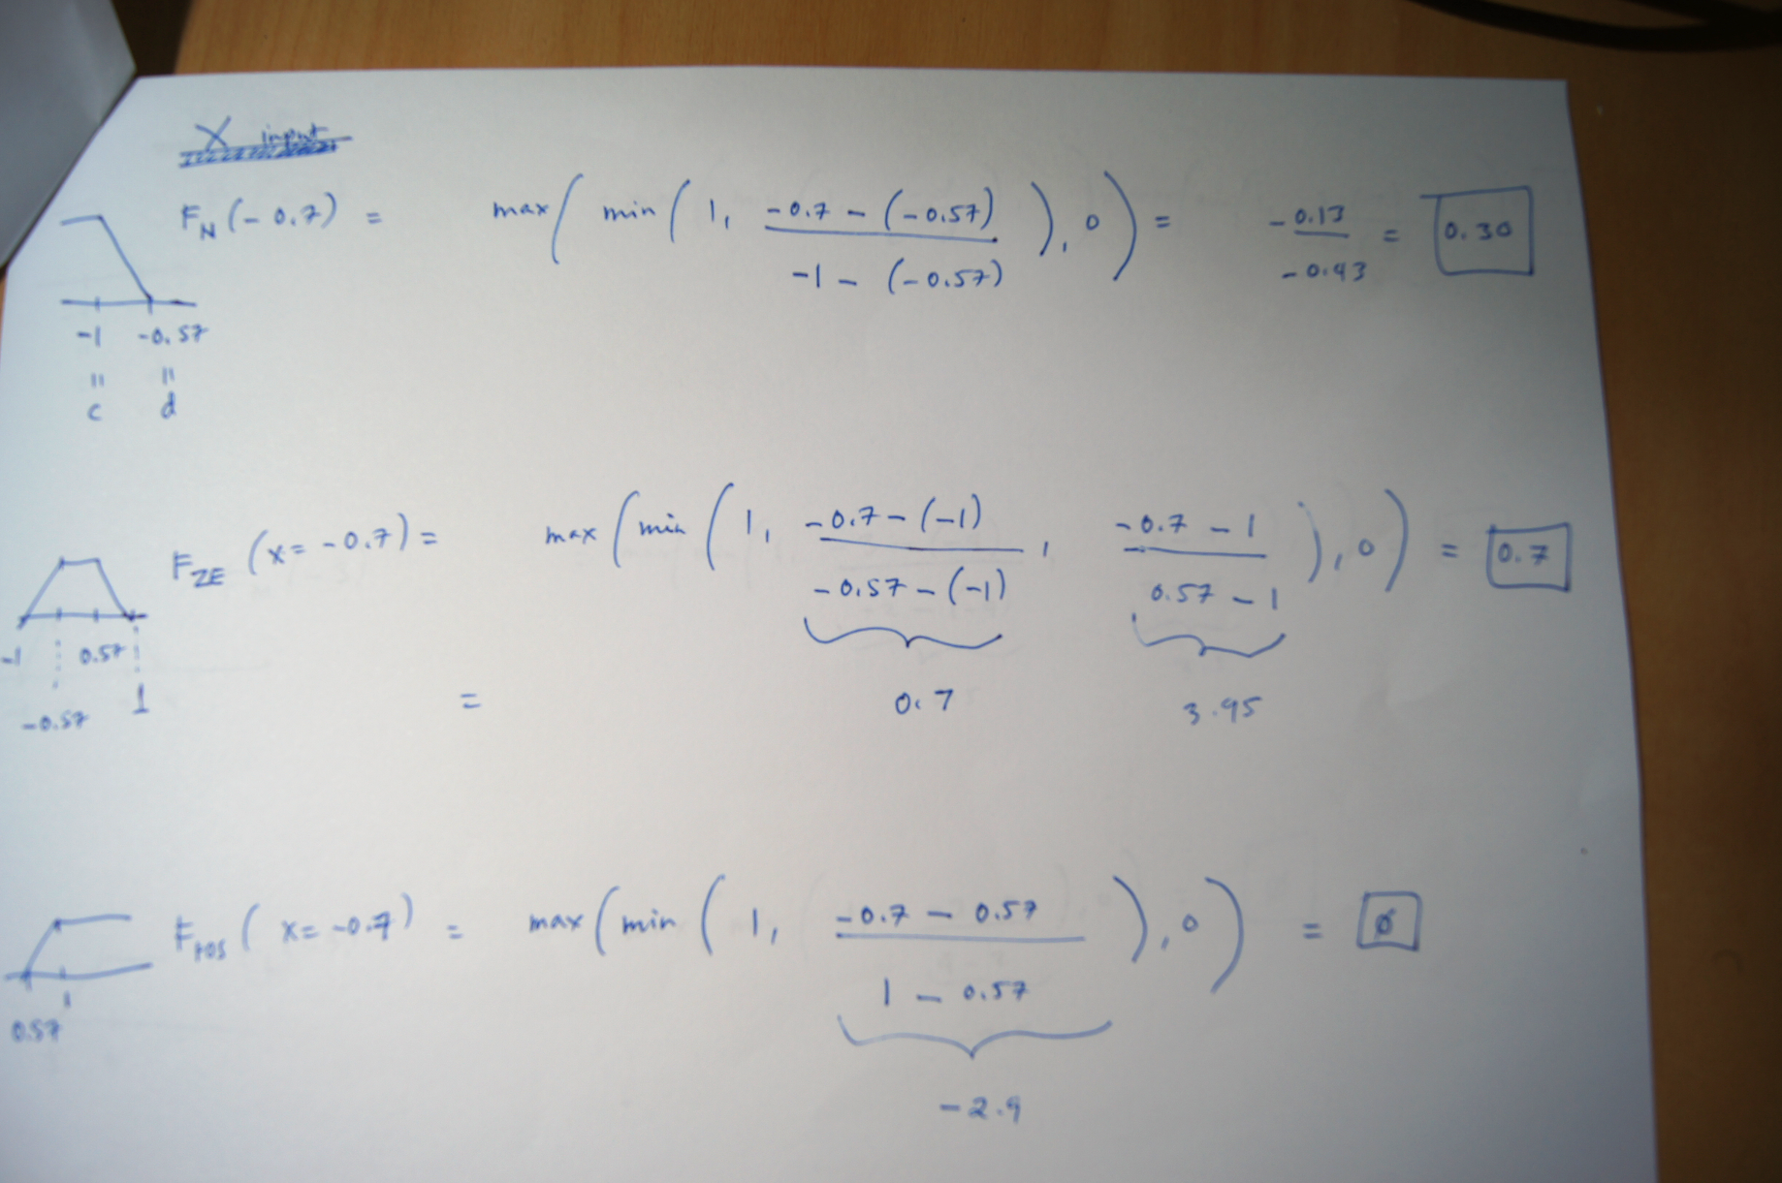


Fuzzy Logic Tutorial
 | a | b | c | d
NEG | 0 | 0 | -1 | -0.57
ZE | -1 | -0.57 | 0.57 | 1
POS | 0.57 | 1 | 0 | 0
Fuzzify the inputs: INPUT VARIABLE X
$$F_{left_{t}rapezoid}(x)=\max\left(\min\left(1,\frac{x−d}{c−d}\right),0\right)$$
$$F_{regular_{t}rapezoid}(x)=\max\left(\min\left(\frac{x−a}{b−a},1,\frac{x−d}{c−d}\right),0\right)$$

Slide 7
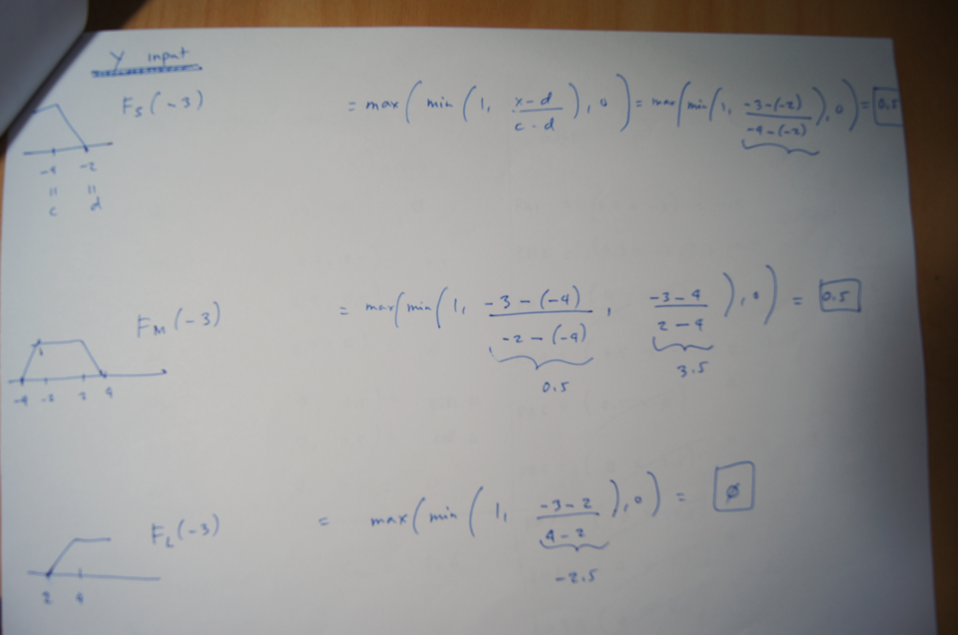
Fuzzy Logic Tutorial
 | a | b | c | d
S | 0 | 0 | -4 | -2
M | -4 | -2 | 2 | 4
L | 2 | 4 | 0 | 0
Fuzzify the inputs: INPUT VARIABLE Y
$$F_{left_{t}rapezoid}(x)=\max\left(\min\left(1,\frac{x−d}{c−d}\right),0\right)$$
$$F_{regular_{t}rapezoid}(x)=\max\left(\min\left(\frac{x−a}{b−a},1,\frac{x−d}{c−d}\right),0\right)$$

Slide 8
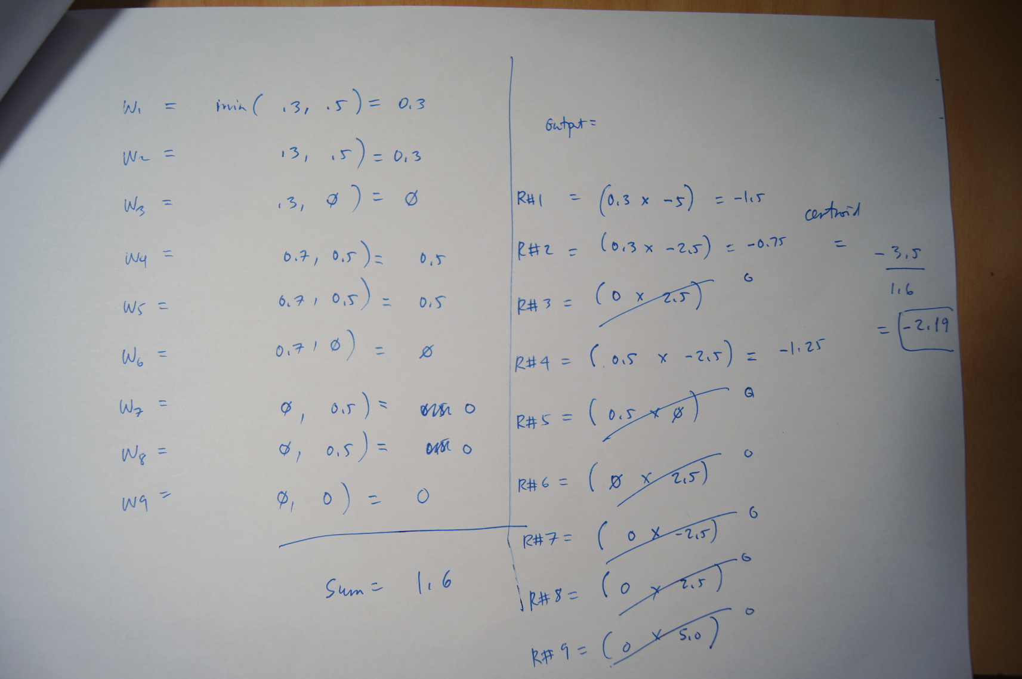

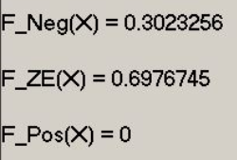
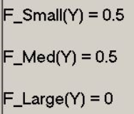


Fuzzy Logic Tutorial
Compute degree of applicability of rules: WEIGHTS
DEFUZZIFICATION: compute crisp output using CENTRE OF MASS

Slide 9
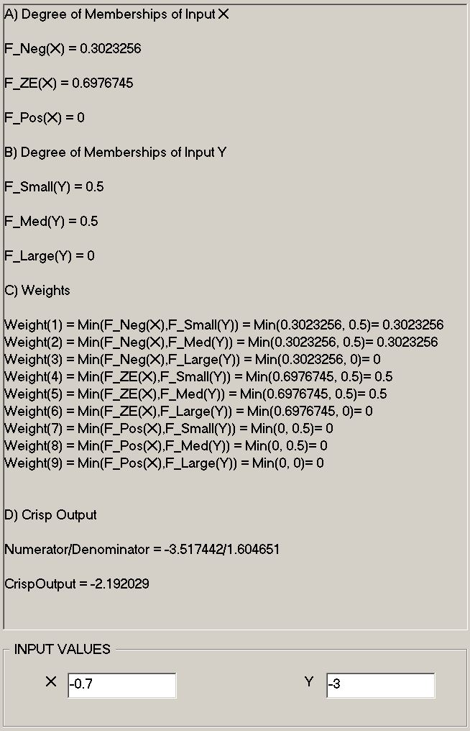
Fuzzy Logic Tutorial
Summary of steps

